Slide 1

Synthetic Approaches Towards A Marine Natural Product, Anomoian B
Nathaniel Davies
and
Lydia Stiles

Slide 2
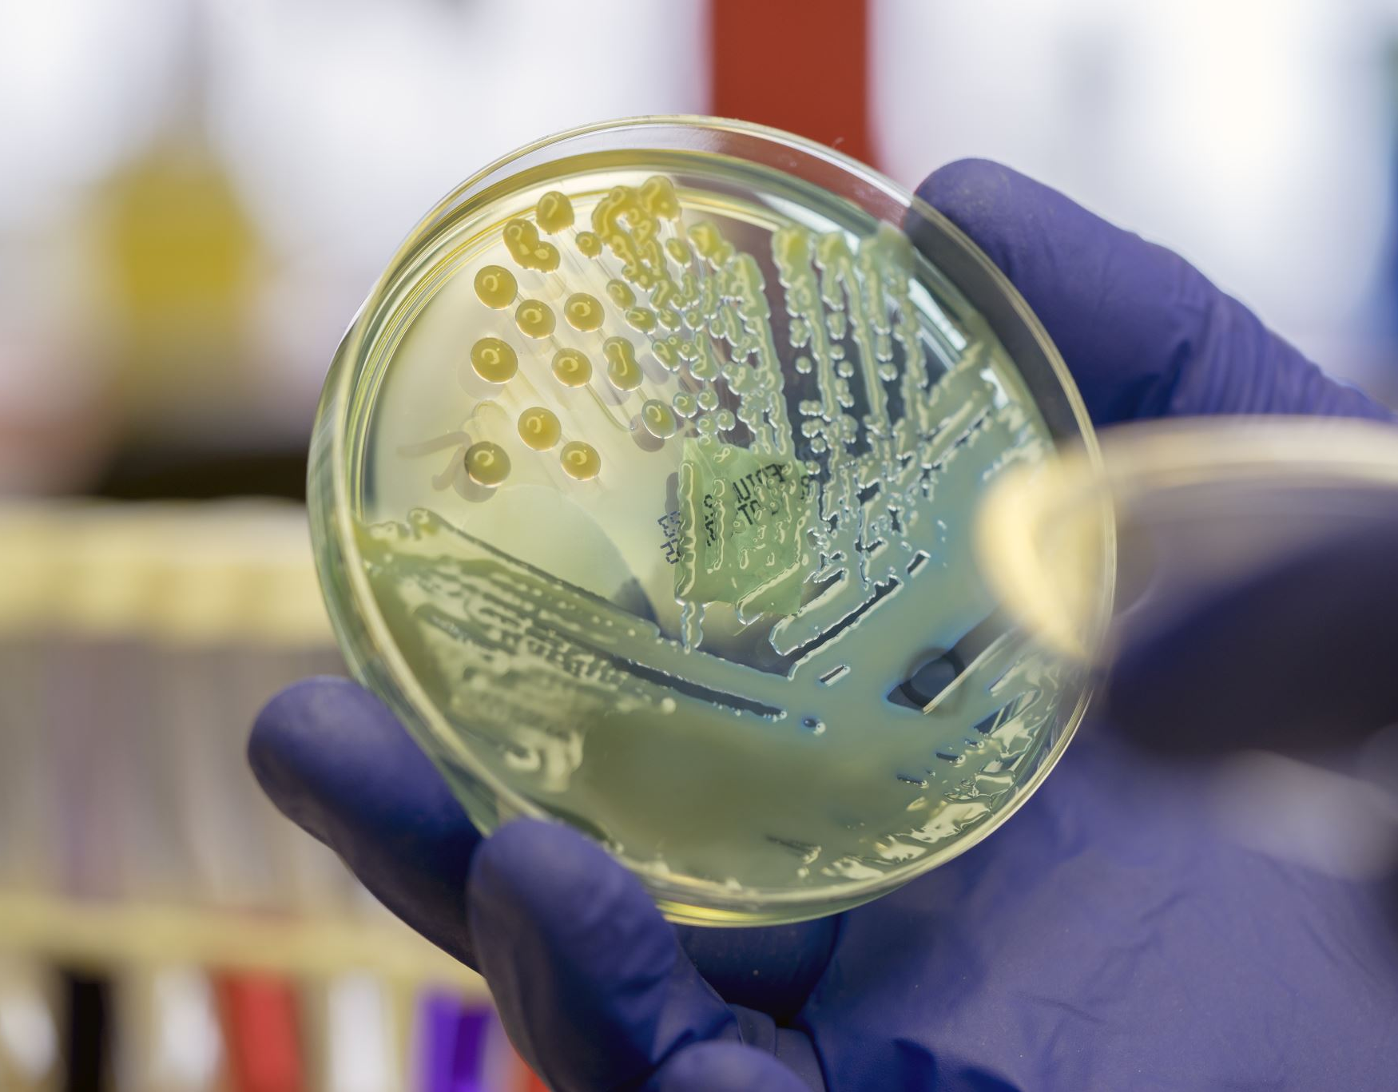
A Growing Concern…
Since 1980s no new classes of antibiotics have been discovered¹
Currently, approximately 700,000 people die each year from resistant bacterial strains. The World Health Organization predicts this number will rise to 10 million by 2050²
Studies have shown that marine animals produce more biologically active substances than any other group of animals³
(1) Mancuso, G.; Midiri, A.; Gerace, E.; Biondo, C. Bacterial Antibiotic Resistance: The Most Critical Pathogens. Pathogens 2021, 10 (10), 1310. https://doi.org/10.3390/pathogens10101310.
(2) Do medicines come from the sea? : Ocean Exploration Facts: NOAA Office of Ocean Exploration and Research. https://oceanexplorer.noaa.gov/facts/medicinesfromsea.html# (accessed 2024-02-24).
(3) Uddin, T. M.; Chakraborty, A. J.; Khusro, A.; Zidan, B. R. M.; Mitra, S.; Emran, T. B.; Dhama, K.; Ripon, Md. K. H.; Gajdács, M.; Sahibzada, M. U. K.; Hossain, Md. J.; Koirala, N. Antibiotic Resistance in Microbes: History, Mechanisms, Therapeutic Strategies and Future Prospects. Journal of Infection and Public Health 2021, 14 (12), 1750–1766. https://doi.org/10.1016/j.jiph.2021.10.020.

Slide 3
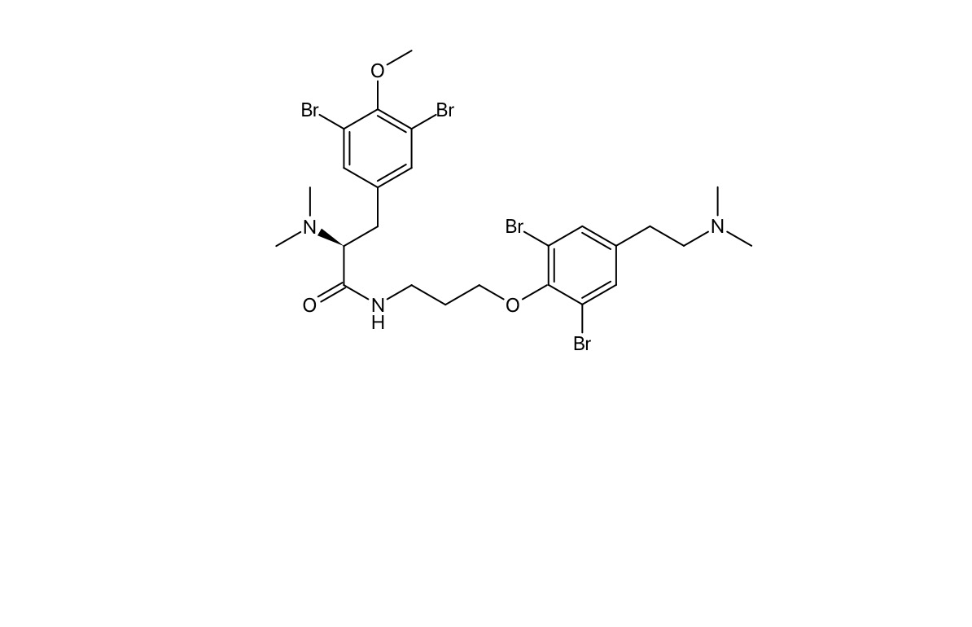
A New Class of Antibiotics
In 2010, a sea sponge from the order Verongida (Hexadella genus), was collected in Indonesia¹
Researchers used ¹H NMR to determine the structure of anomoian B
They determined this compound could be a potent antibiotic because of its cytotoxic capabilities but performed no further testing
The chemical structure of anomoian B
(1) Tarazona, G.; Santamaría, G.; Cruz, P. G.; Fernández, R.; Pérez, M.; Martínez-Leal, J. F.; Rodríguez, J.; Jiménez, C.; Cuevas, C. Cytotoxic Anomoian B and Aplyzanzine B, New Bromotyrosine Alkaloids from Indonesian Sponges. ACS Omega 2017, 2 (7), 3494–3501. https://doi.org/10.1021/acsomega.7b00417.

Slide 4

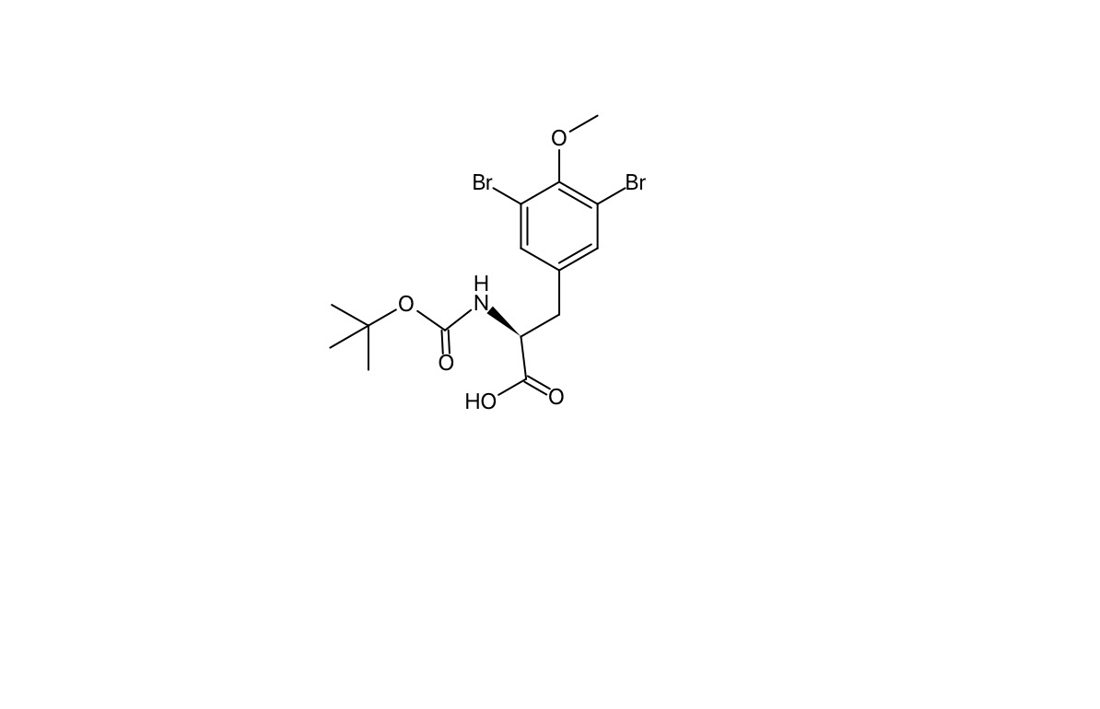
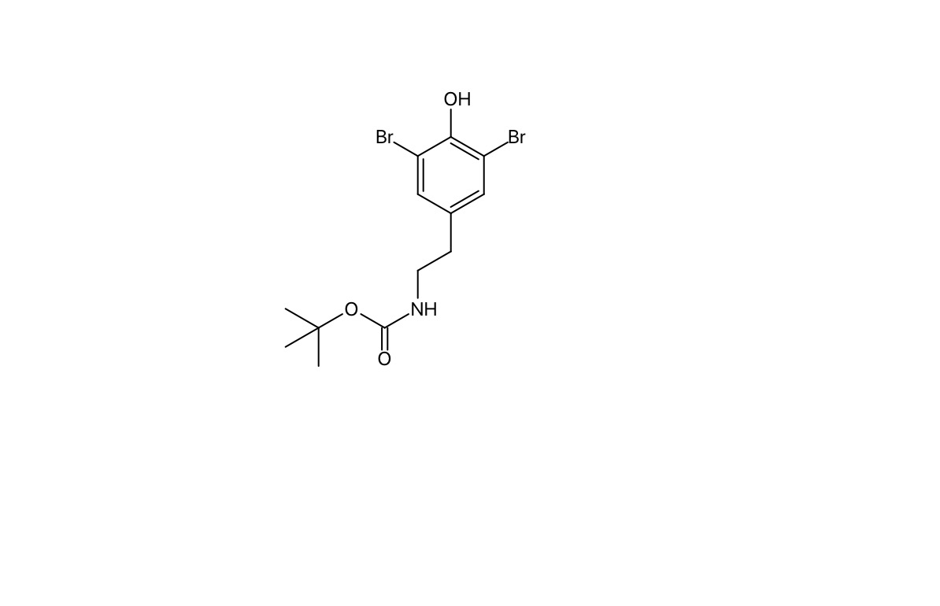
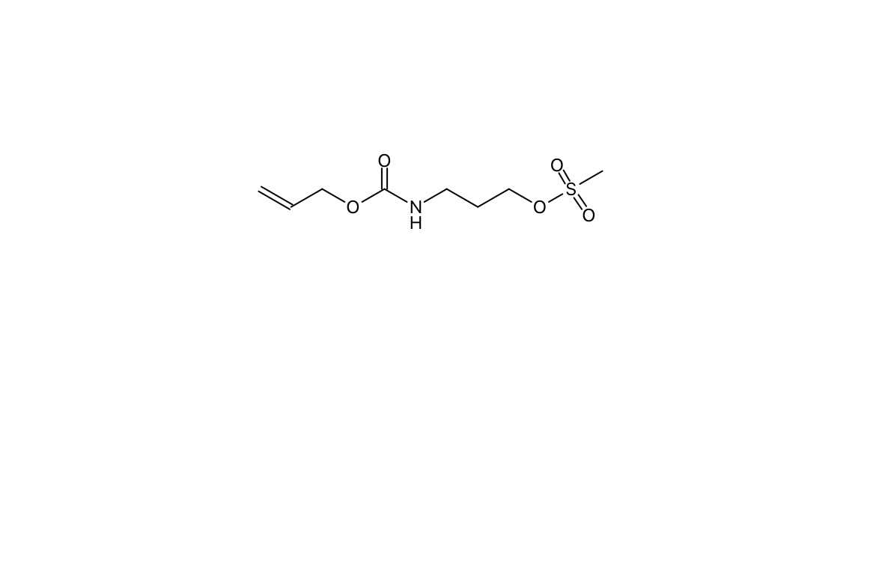

Synthesis of Anomoian B
Fragment 1
Fragment 2
Anomoian B
Fragment 3

Slide 5

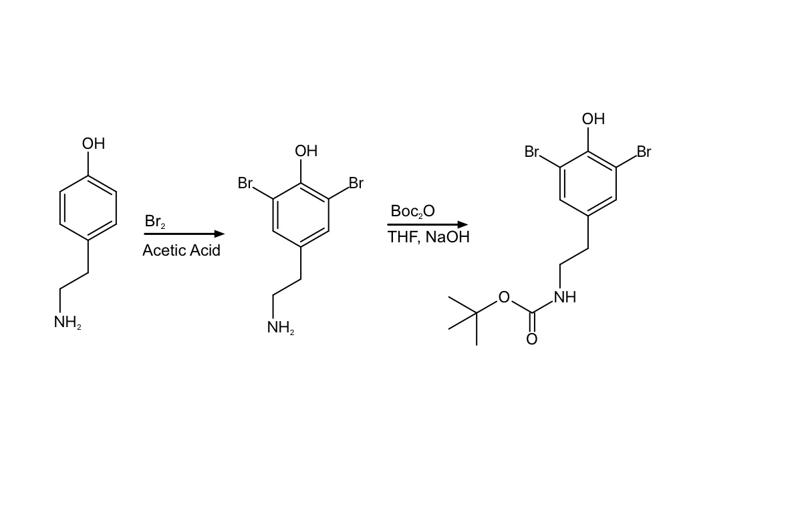
Fragment 2 Synthesis
We have successfully finished the synthesis of this piece
The compound was confirmed using ¹H NMR, ¹³C NMR, IR spectroscopy, and mass spectrometry
There is some interesting stereochemistry in the boc-dibromotyramine that caused some unexpected signals in the ¹H NMR
Tyramine
Dibromotyramine
Boc-dibromotyramine
Notes:
Retr

Slide 6
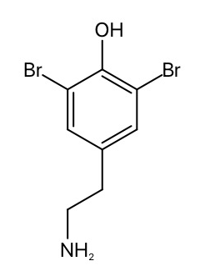
¹H NMR for Dibromotyramine
H_{c}
H_{b}
2
2
H_{a}
2
H_{a}
H_{a}
H_{c}
H_{b}
H_{c}
H_{b}

Slide 7
¹H NMR for Boc-Dibromotyramine
H_{d}
H_{a}
H_{a}
H_{c}
H_{b}
H_{c}
H_{b}
H_{d}
H_{a}
H_{d}
H_{c}
H_{b}
H_{d}
H_{d}
H_{d}
H_{d}
H_{d}
H_{d}
H_{d}

Slide 8
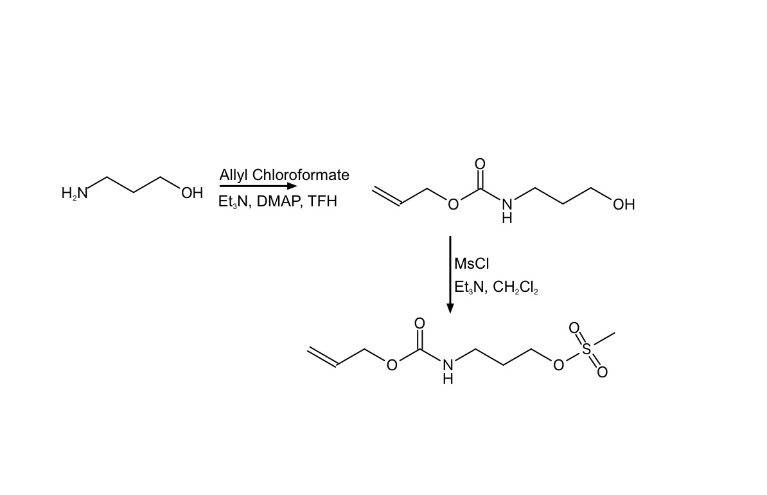
Fragment 3 Synthesis
The synthesis of this compound was completed in two steps
As shown in the ¹H NMR, the synthesis of this fragment was successful

Slide 9
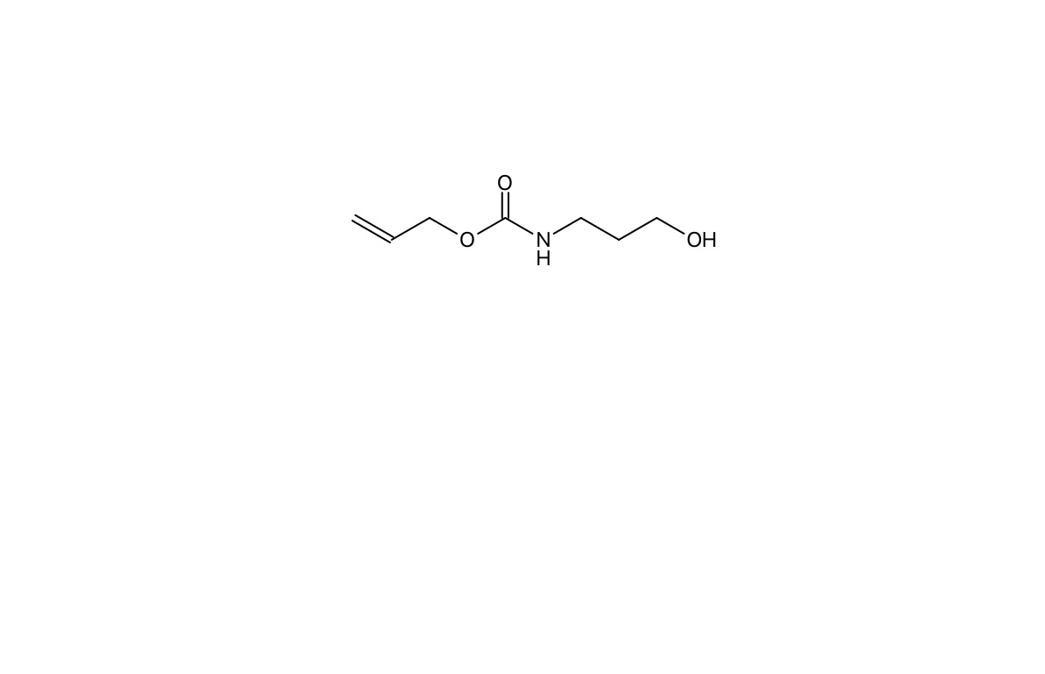
¹H NMR for Fragment 3
H_{e}
H_{c}
H_{a}
H_{d}
H_{f}
H_{a}
H_{c}
H_{c}
H_{d}
H_{d}
H_{f}
H_{f}
H_{b}
H_{a}
H_{b}
H_{e}
H_{e}

Slide 10
¹H NMR for Fragment 3
H_{a}
H_{c}
H_{a}
H_{c}
H_{d}
H_{c}
H_{d}
H_{d}
H_{f}
H_{f}
H_{f}
H_{e}
H_{a}
H_{b}
H_{e}
H_{e}
H_{b}

Slide 11
Conclusion
In the future, we will collaborate with biology faculty to develop a procedure for analyzing the antibacterial properties of anomoian B
Fragment 1
Fragment 2
Anomoian B
Fragment 3

Slide 12


Acknowledgments
Thank you to the following funding sources:
CSU Council on Ocean Affairs, Science & Technology (COAST)
CSU STAN Research, Scholarship and Creative Activity (RSCA)
This research activity is funded all or in part by the Stanislaus State ASPIRE program through a U.S. Department of Education Title III Grant #P031C210159
Thank you, Michele Gordon, Dr. Nhu Y and Dr. Chad Stessman for their time spent supporting this project

